Slide 1
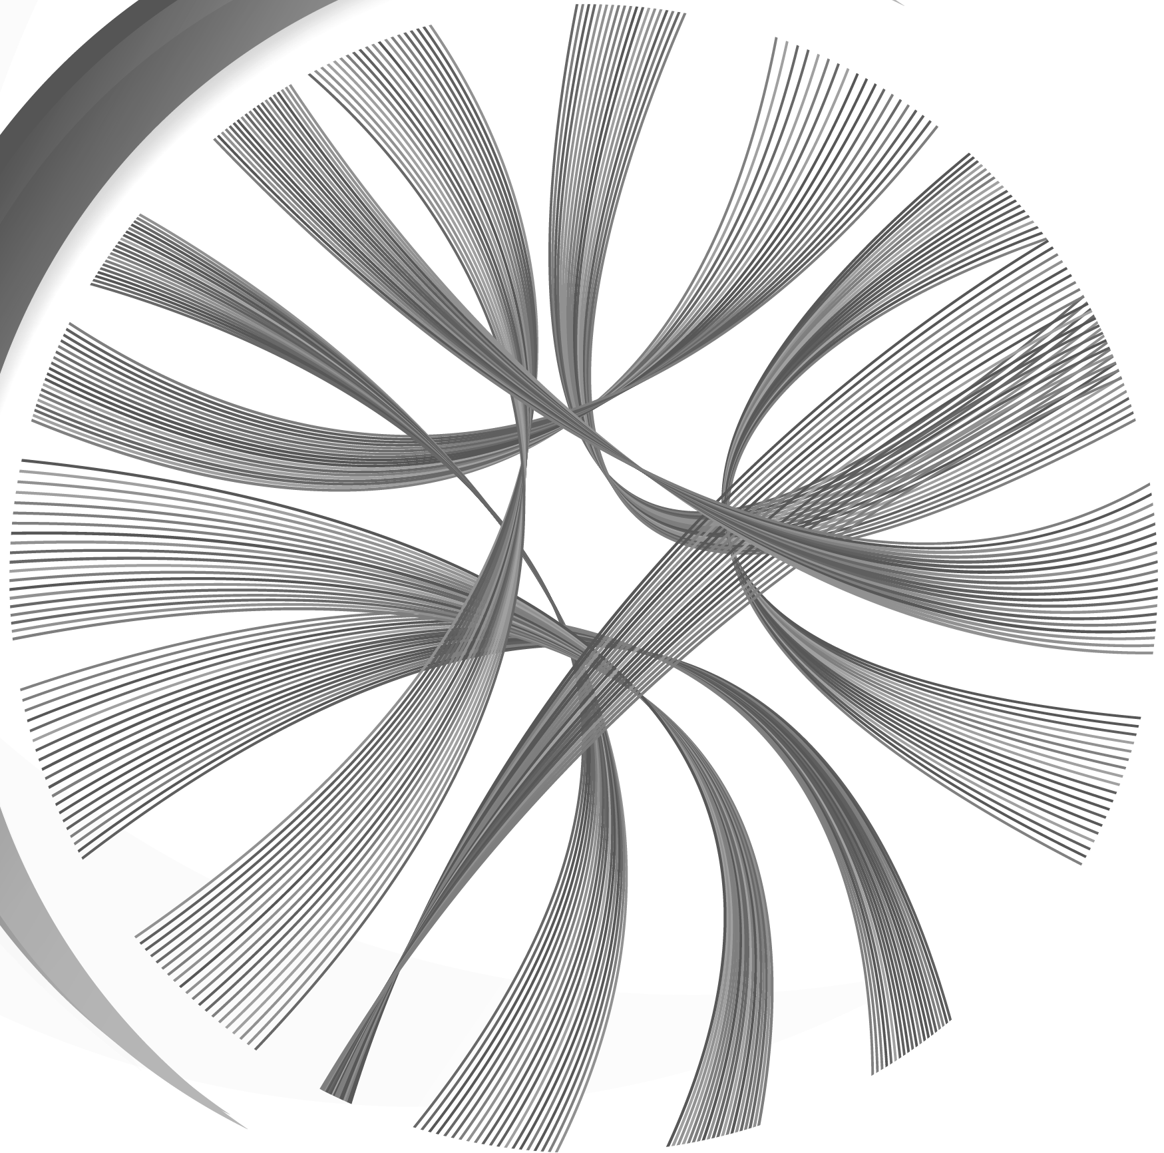


Making Sense of the Cancer Multi-dimensional data
BACKED BY :
First company from Asia Pacific region to be selected for the Illumina Accelerator program

Slide 2
Background of the Project

Slide 3
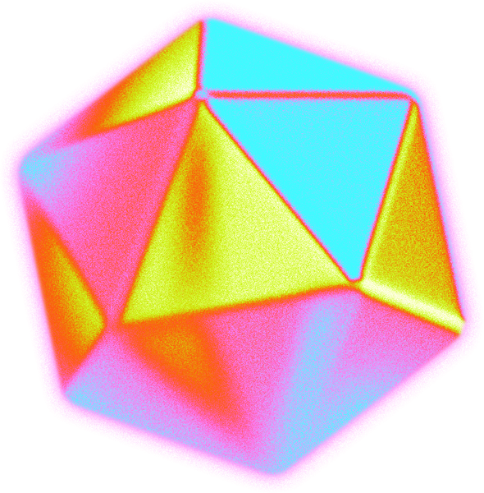
The multidimensional nature of cancer data
DNA-seq
Variants data from DNA-seq
RNA-seq
Medical Data
Fusion and RNA-seq data wherever available
Cancer type, size of tumours, laterality, risk factors, therapy
Demographic Data
Survival Data
Age, Gender, Ethnicity, Smoking and Alcohol
OS, RFS, response to treatment, etc
Lab Tests
Test results from pathological tests – PDL1, HER2, etc

Slide 4
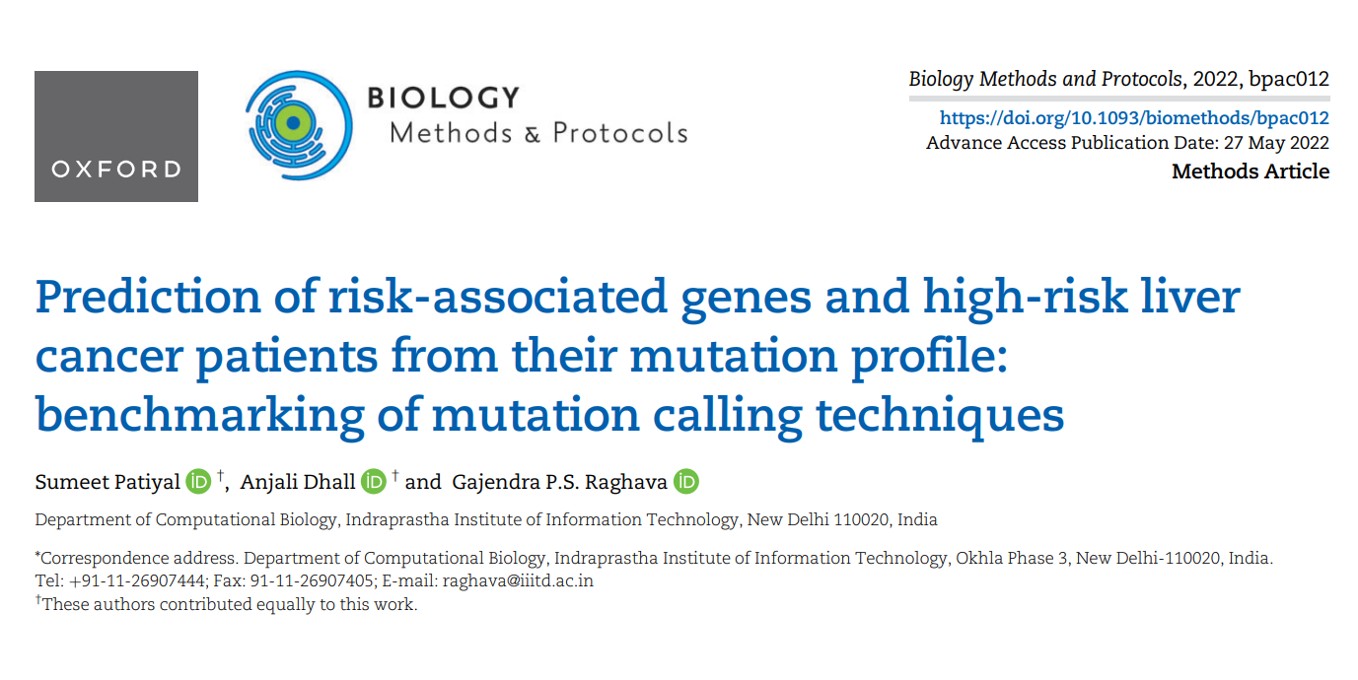
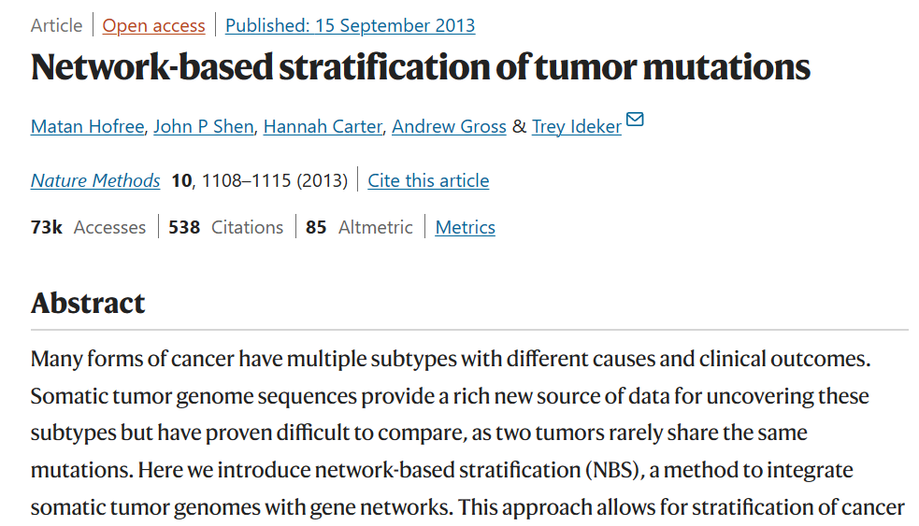
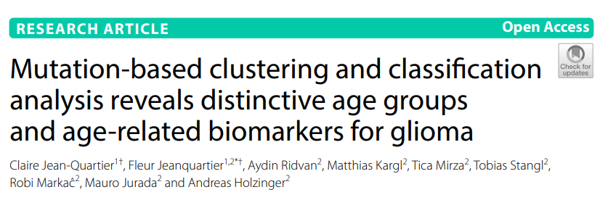
The Clustering of Cancer patients: Attempts recorded in the literature
20+

Slide 5
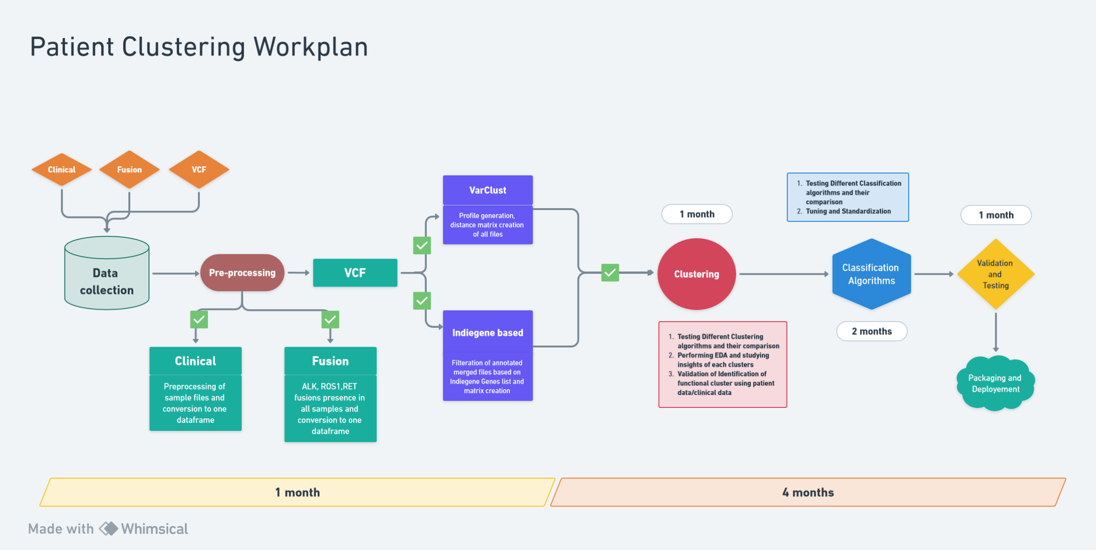
Overall Workflow

Slide 6
Approaches for Varclust and Indiegene method:
Varclust
Indiegene
oOld method
oNew method
AF
PASS
Filter using Indiegene genes
Filter file using DP and Nonsynonymous
Figure: Two methods have been used to filter files for Varclust and Indiegene based method.

Slide 7
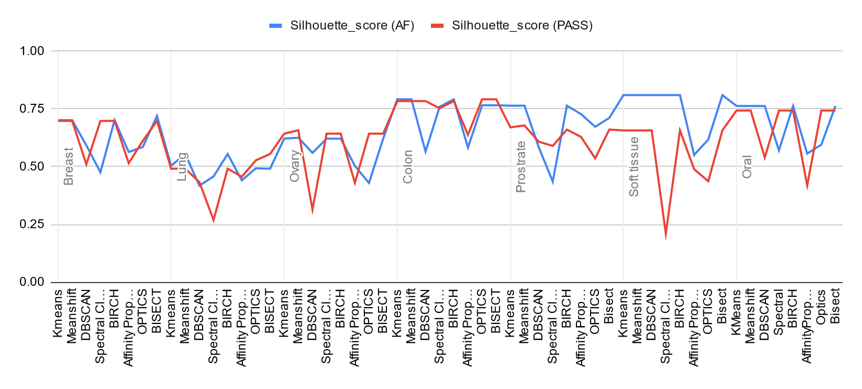
Clustering algorithms on Varclust:
Figure: Validation of clusters using silhouette scores and comparison of two filter methods for different cancer types

Slide 8
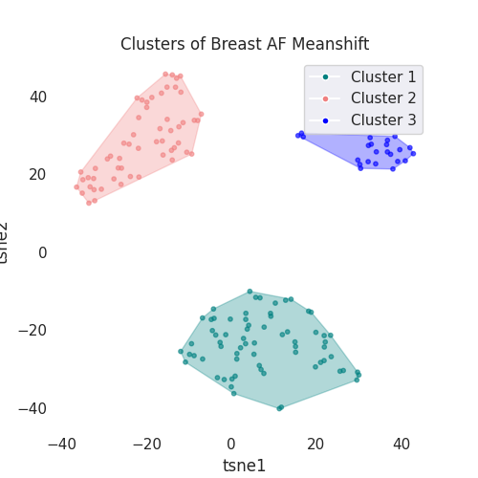
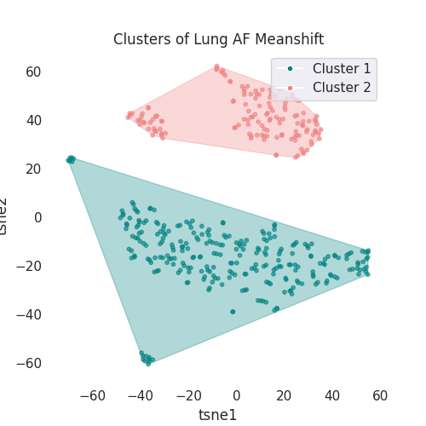
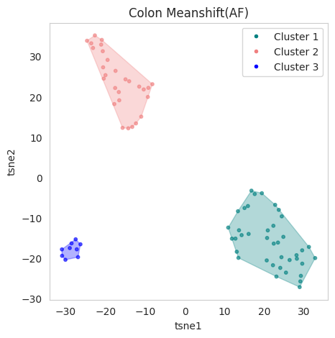
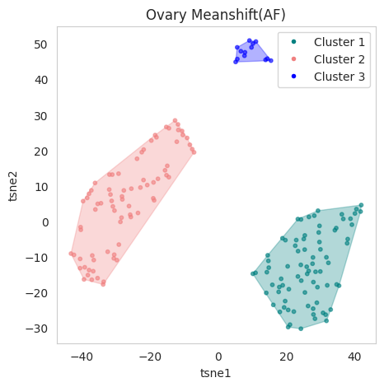
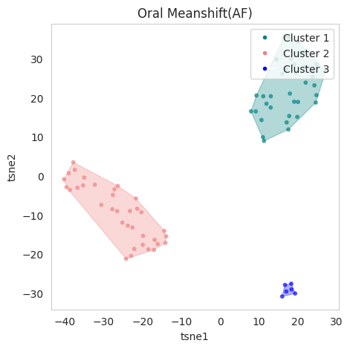
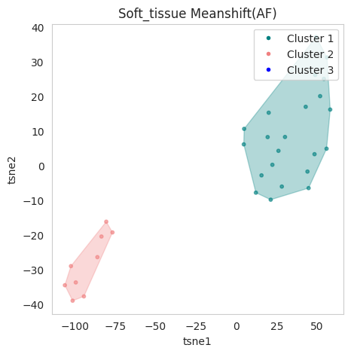
Results from Varclust + Meanshift
Figure: Convex hull of each cancer using meanshift clustering algorithm

Slide 9
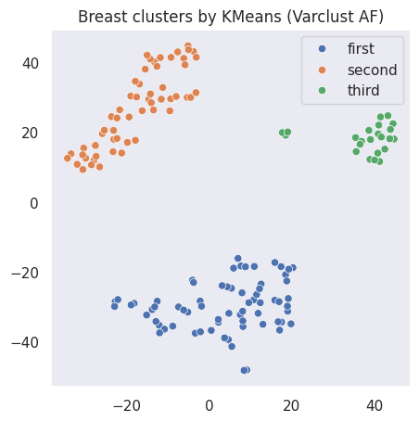
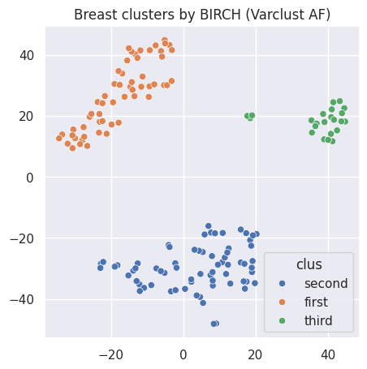
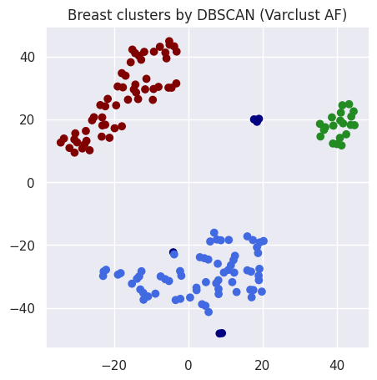
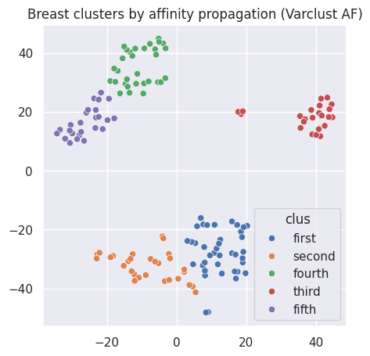
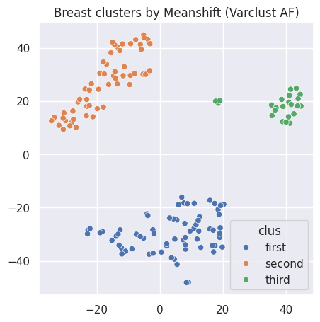
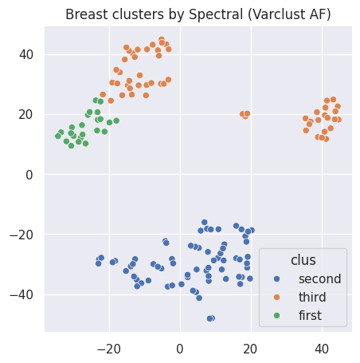
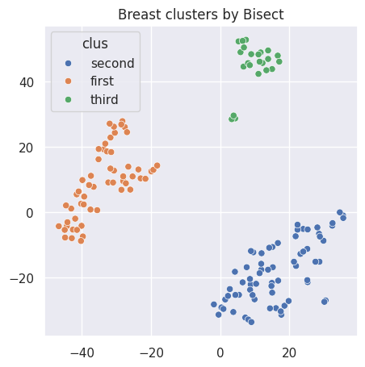
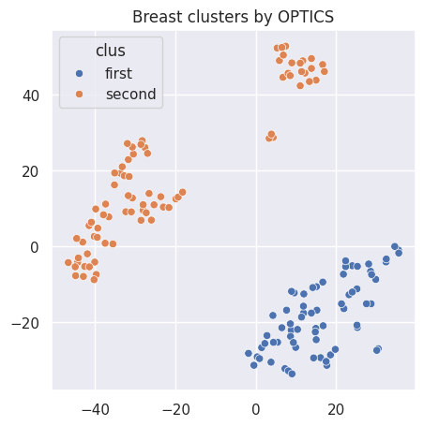
Clusters of Varclust (AF):
Figure: Example of cluster plots of Varclust using AF ( >= 0.01 and <= 0.5) filter on VCF file.

Slide 10
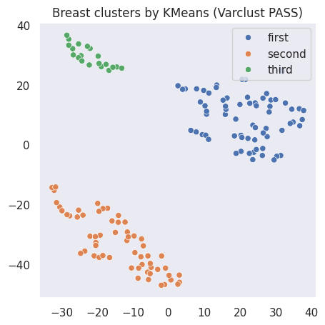
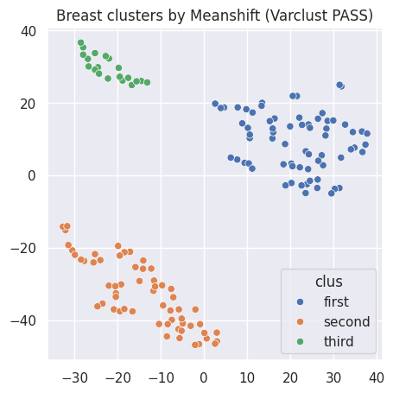
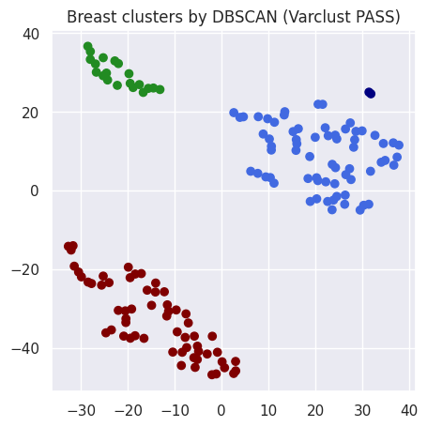
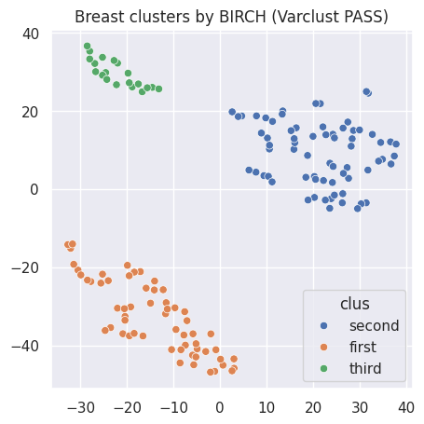

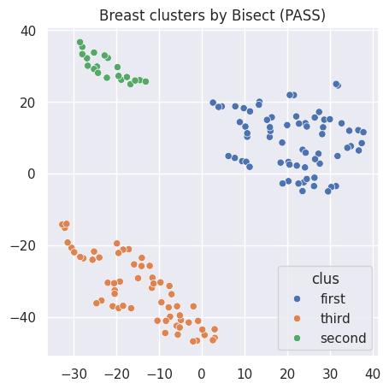
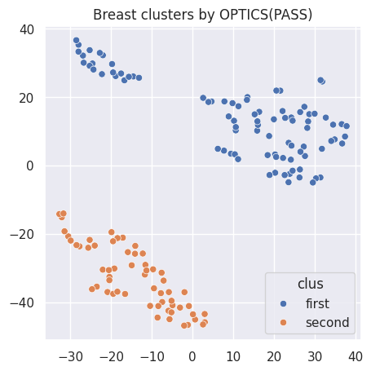
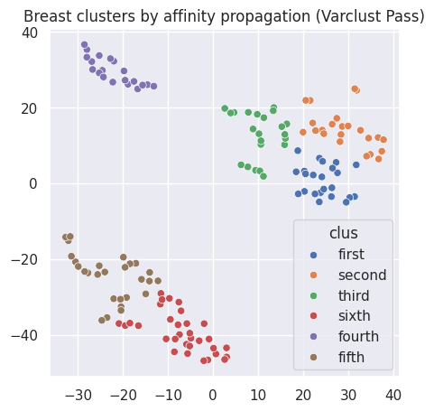
Clusters of Varclust (PASS):
Figure: Examples of cluster plots of Varclust using PASS filter on VCF file.

Slide 11
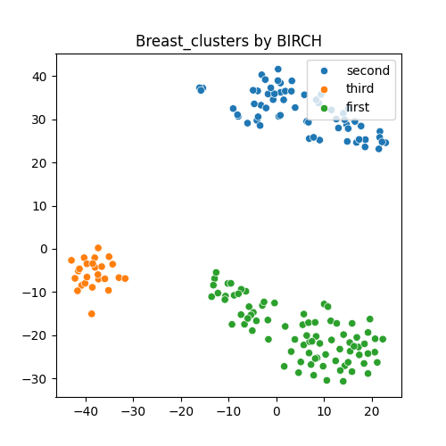
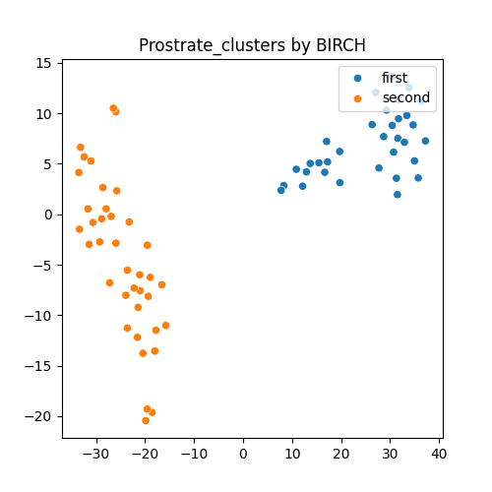
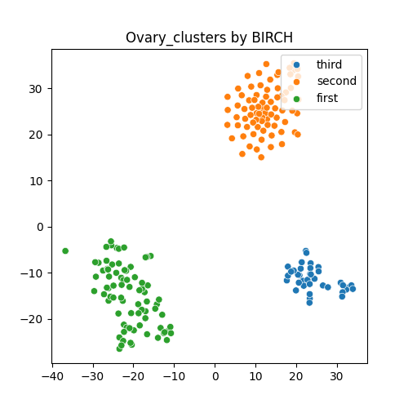
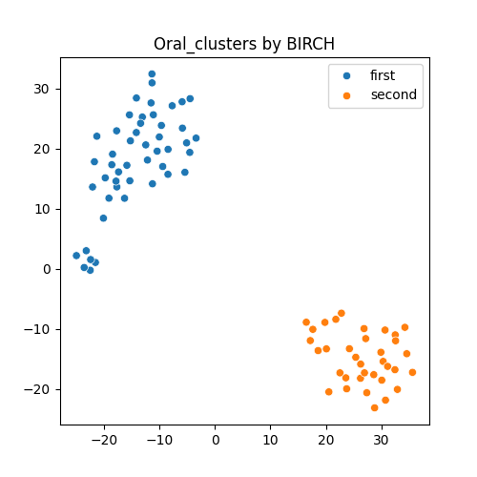
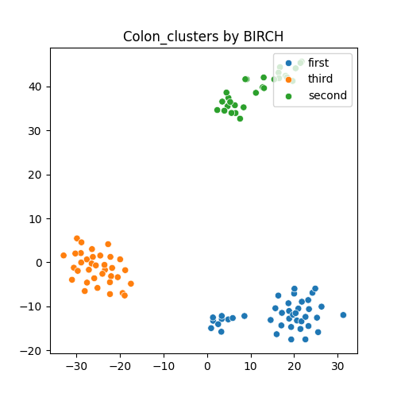
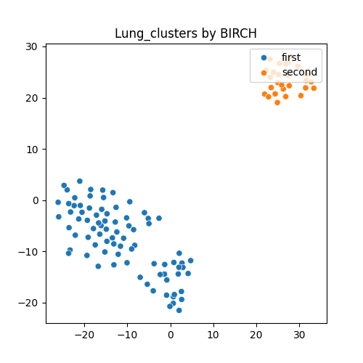
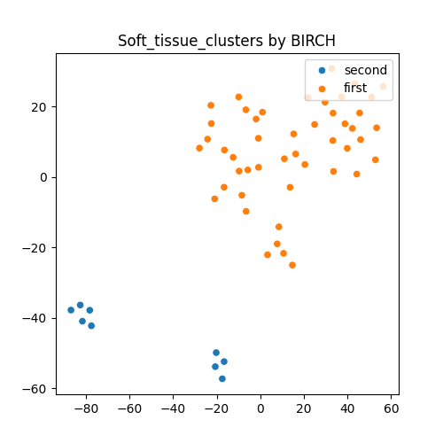
Results from IndieGene Matrix + BIRCH
Figure: Cluster plot of each cancer using BIRCH clustering algorithm (Old method: Filterered file using Indiegene genes)

Slide 12
Demographic Insights
Age
Cancer | Cluster1 | Cluster2 | Cluster2
Breast | [42-52], [52-62] | [56-66] | [45-55]
Lung | [53-63] | [56-66] | [60-70]
Colon | [50-60], [60-70] | [32-42], [62-72] | [54-64]
Ovary | [51-61] | [48-58] | [51-61]
Gender
Cancer | Cluster1 | Cluster2 | Cluster2
Breast | 100% Female | 93.44% Female | 97.5% Female
Lung | 62.54% Male | 55.73% Male | 72.72%
Colon | 50% Male 50% Female | 57.14% Female | 65.71% Male
Ovary | 100% Female | 100% Female | 100% Female

Slide 13
Top mutated genes present in clusters, few examples
LUNG | Cluster1 | Cluster2 | Cluster3
Number of genes present in all samples | 222 (AARS2, ABCC2,AFF3,APOB etc) | 340 (AFP,AFF3,ABL1 etc.) | 27 (ALK,ATM,EGFR,KRAS,MET,AXL,AARS2 etc.)
Number of genes not present in any samples | 139 (AFP,ACTB,ARNT,CD5 etc) | 2 (MEG3,CRLF2) | 7 (AARS2,POLD4,RBX1,TERC,SRY,CRLF2,TTTY15)
Breast | Cluster1 | Cluster2 | Cluster3
Number of genes present in all samples | 388 (ABL1,AIP,ALK, ALG1,CASR,BRAF, etc) | 22 (ABL1, AXL, BRCA2, EDFR,KRAS,MSH2 etc) | 412 (AFP,ALK,ABL1,BRCA2, BCL6 etc)
Number of genes not present in any samples | 2 (MEG3, SRY) | 136 (CKB,ACTB,B2M, ANO1) | 10 POLD4, POLE3 etc

Slide 14
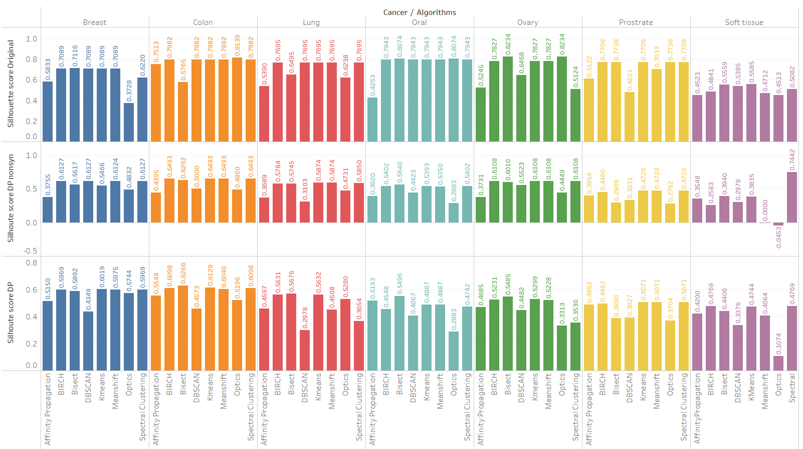
Alternative approaches and their Results:
Filtered merged annotated files based on DP (>=10). Filtered merged annotated files based on DP and “Nonsynonymous”.
Figure: Validation of clusters using silhouette scores and comparison of the new approach and the old approach for different cancer types

Slide 15
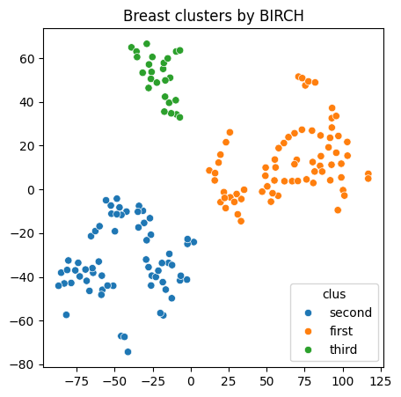
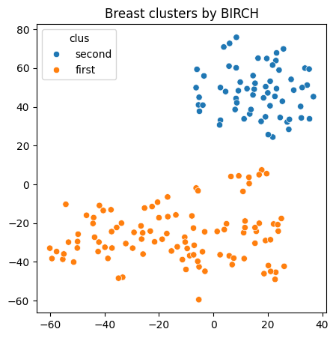
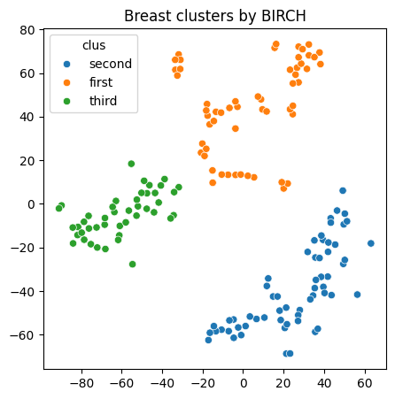
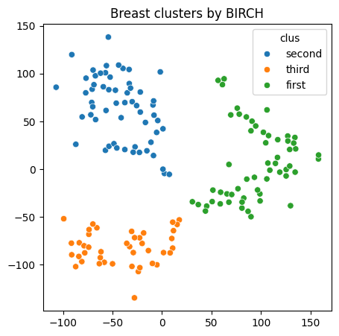
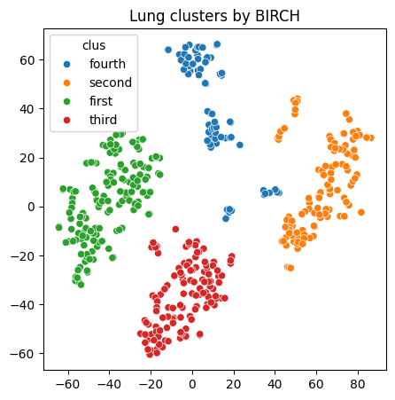
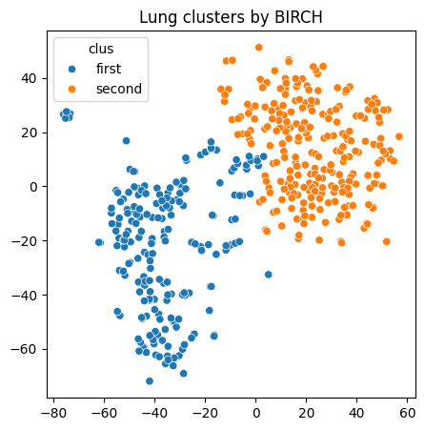
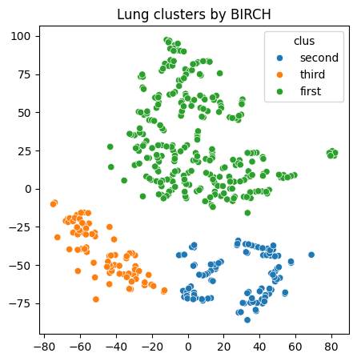
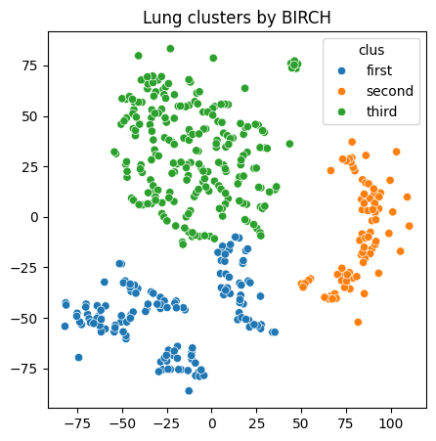
Clusters from Indiegene after applying filters:
DP
DP (Jaccard index)
DP & Nonsynonymous (Jaccard index)
DP & Nonsynonymous
Figure: Examples of cluster plots for each method.

Slide 16
Demographic Insights:
Age (DP)
Cancers | Cluster 1 | Cluster 2 | Cluster 3
Breast | 30-59 | 50-60 | 54-64
Lung | 49-59 | 60-70 | NA
Colon | 33-43 | 33-43, 53-63 | 42-67
Prostrate | 53-63 | 65-75 | NA
Ovary | 43-53 | 46-56 | 53-63
Oral | 43-53 | 53-63 | NA
Soft tissue | 30-40 | 12-22 | NA
Figure: Most frequent age distribution per cluster for each cancer using both approaches.
Age (DP & Nonsynonymous)
Cancers | Cluster 1 | Cluster 2 | Cluster 3
Breast | 50-60 | 54-64 | 40-50
Lung | 49-59 | 60-70 | NA
Colon | 41-51,51-61,61-71 | 42-52 | 33-43
Prostrate | 56-66 | 20 | NA
Ovary | 46-56 | 46-56 | NA
Oral | 43-53 | 53-63 | NA
Soft tissue | 32-42 | 18-28 | NA

Slide 17
Gender (DP)
Cancers | Cluster 1 | Cluster 2 | Cluster 3
Breast | 94.02% Female | 97.33% Female | 100% Female
Lung | 62.36% Male | 57.87% Male | NA
Colon | 53.84% Female | 62.5% Male | 100% Male
Prostrate | 100% Male | 100% Male | NA
Ovary | 100% Female | 100% Female | 100 Female%
Oral | 84.21% Male | 87.87% Male | NA
Soft tissue | 64.28% Male | 50% Male | NA
Figure: Percentage of gender distribution in each cancer using both approaches.
Gender (DP & Nonsynonymous)
Cancers | Cluster 1 | Cluster 2 | Cluster 3
Breast | 97.22% Female | 95.23% Female | 100% Female
Lung | 57.87% Male | 62.36% Male | NA
Colon | 50% Female | 68.75% Male | 53.84% Female
Prostrate | 100% Male | 100% Male | NA
Ovary | 100% Female | 100% Female | NA
Oral | 88.88% Male | 82.85% Male | NA
Soft tissue | 50% Male | 64.28% Male | NA

Slide 18
Top mutated genes present in clusters, few examples
DP
LUNG | Cluster1 | Cluster2 | Total
Number of genes present in all samples | 138 ALK, SYNE1,NEB,NOTCH1 DMD etc | 11 ALK,EGFR, RET,BARD1,NTRK1 etc. | 1193
Number of genes not present in any samples | 5 MAPKAPK5, CBX3, HPRT1, SMARCD2, etc | 1 TERC | 1193
DP & Nonsynonymous
LUNG | Cluster1 | Cluster2 | Total
Number of genes present in all samples | 34 SYNE1, FAT1, NEB, KMT2C, etc | 1 ALK | 1188
Number of genes not present in any samples | 49 POLE3, EPOR,POLD4,etc | NA | 1188

Slide 19


